Slide 1
Hackathon

Slide 2
Why are you here?
IT systems aren’t just supporting businesses anymore
They are the business and form a key differentiator
But no-one differentiates on the plumbing...
Applications are crucial, and understanding a bit about how they are actually made will make you more effective

Slide 3
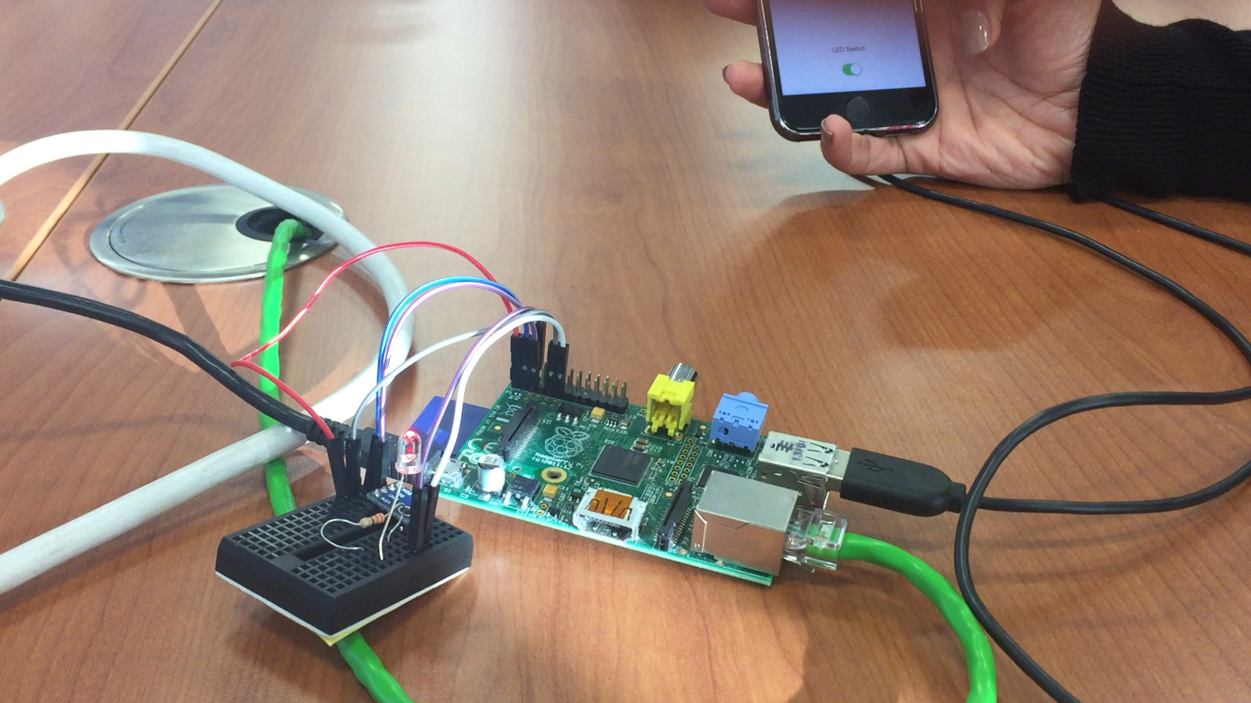

Slide 4
Programming 101
Compiled or Interpreted, OO or procedural
Variables & Scope
More complex data structures
Maths
IF/THEN/ELSE
Loops
Functions/Methods
Objects
Google is your friend

Slide 5
Types of Languages

Slide 6
Basic Concepts: Variables
Stores data temporarily in memory
Most languages require a type of variable
String myName = “Andrew”
Int myAge=“50”
Scope defines where in my language my variable exists – normally defined by which “block” of code you assign the variable in

Slide 7
Basic Concepts: Data Structures
Variables store one item of data
Arrays store multiple:
Array ShoppingList = [“Apples”,”Pears”,”Oranges”]
And some are “multi-dimensional” – allowing key/value type data structures
AssociativeArray NameToAge =[“Andrew”:”50”,”Fred”:”60”]

Slide 8
Basic Concepts: Maths
All languages allow you to perform mathematical functions, often by inputting variables
Int x = 10
Int y = 5
Int result
result = x * y

Slide 9
Basic Concepts: IF THEN ELSE
Implementing logic like decision trees
If variableX < variableY DO
print “Variable X is less than Y”
ELSE
Print “Variable X is NOT less than Y”

Slide 10
Basic Concepts: Loops
Allows you to repeat code multiple times until a condition is met
While X < 100 DO
Print X
X=X+1 (or X++)
END
FOR X=1, X<100,X++
Print X
END

Slide 11
Basic Concepts: Functions / Methods
Allows reusable code, or to use external libraries
FUNCTION addNumbersTogether (inputx,inputy)
Result= inputx + inputy
RETURN result
END
myNumber=addNumbersTogether(inputx,inputy)

Slide 12
Basic Concepts: Object
Class MyPersonObject:
Var Name
Var Age
END
FOREACH person DO
myPerson=new MyObject(Name,Age)
END

Slide 13
A side note…

Slide 14
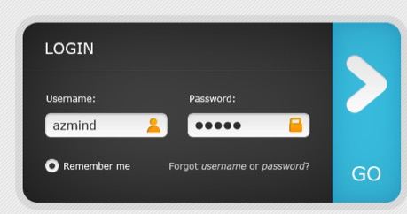
“” or 1=1” / “” or 1=1”
$userId = $_GET["UserId”];
$password = $_GET[“Password”]
$txtSQL = "SELECT * FROM Users WHERE UserId = $userId AND password=$password;
SELECT * FROM Users WHERE UserId = “” or 1=1 AND password = “” or 1=1”
SELECT * FROM Users WHERE UserId = “targetUser” AND password = “” or 1=1”

Slide 15
Github
We’ll need to create you a GitHub account
You need to install git on your mac/windows machine
Robbie will add you to our hackathon repository
Once done, run the following commands:
git clone https://www.github.com/RobbieJ/SEHack
Go into your team’s directory and add a text file to test it works
git add *
git commit -m "Commit message”
git push origin master
Whenever you make changes, repeat steps, git add *, git commit & git push
As people make changes to their projects, you will be required to run a git pull before a push to sync changes – this is how git merges code changes
More info here http://rogerdudler.github.io/git-guide/

Slide 16
Challenges

Slide 17
3 Projects
Using a Raspberry Pi & a temperature / humidity sensor, collect environmental data and feed it back to an internet based collector
Extra tasks:
Add additional sensors to collect more environmental data
Build a web app to display environmental data contained in an existing database
Extra tasks:
Draw graphs
Implement a login system
Create an iOS application that queries a web API to get environmental data and displays the data on screen
Extra Tasks:
Create a notification when conditions are exceeded

Slide 18
Part 2

Slide 19
Extra Projects
You’ve been given a poorly documented, poorly written ☺ docker container containing the API endpoint.
As a group, you need to work on a set of enhancements to all 3 projects to provide extra functionality.
An idea:
Can you make a button on the mobile phone & web interface to turn on a LED on the Raspberry Pi? (use a resistor!)
Anything else?
You’ll need a Docker Account to push your new API/container to and then use ECS to pull/run

Slide 20
What have you learnt?
Who thought about the following when you were building today:
Scalability of your application?
Security of your application?
Data persistence?
Latency & networking considerations?
Monitoring?
Documentation?
Failure scenarios?

Slide 21
What have you learnt?
Our cloud native portfolio is looking to assist in some of those areas
You’ve seen what the fuss about containers is, you’ve used some tooling & built a integrated application stack

